Slide 1
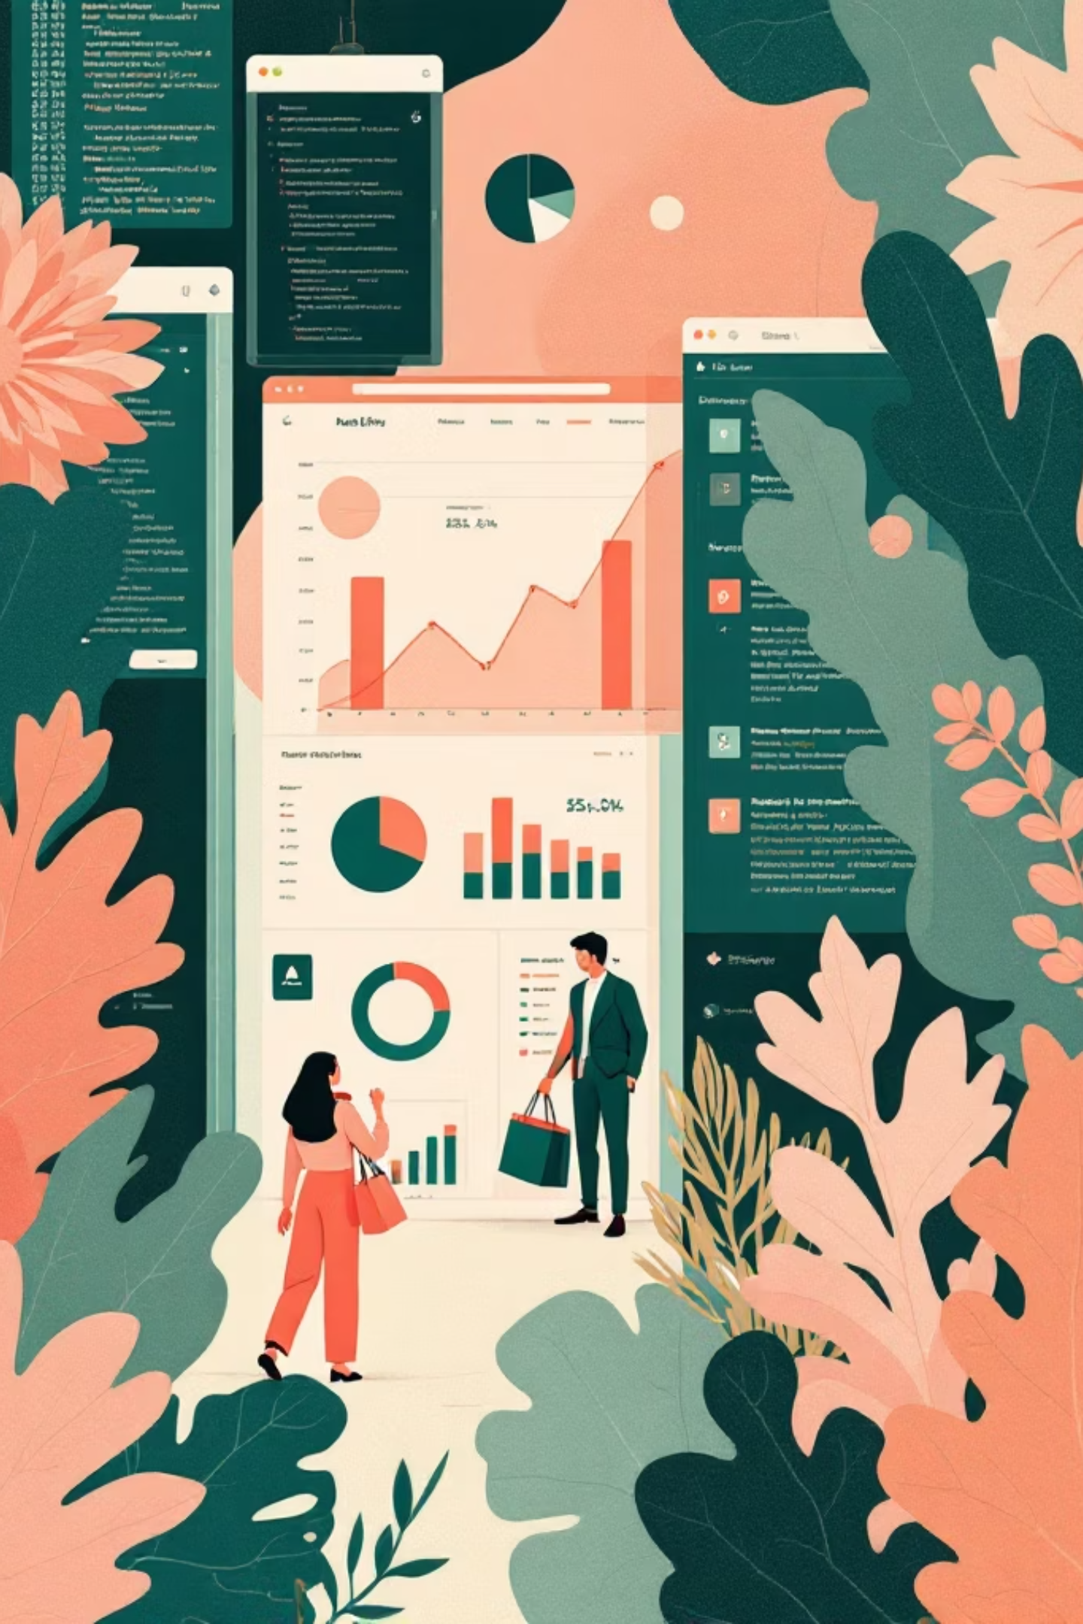
Customer Shopping Behavior Analysis
Summary of insights from 3,900 transactional records across categories to inform revenue, segmentation, product, and subscription strategy.

Slide 2

Project Overview
Scope & Goal
Analyze 3,900 purchases to uncover spending patterns, customer segments, product preferences, and subscription behavior to guide strategy.
Dataset
18 columns including demographics, purchase details, behavior signals; 37 missing review ratings.

Slide 3

Data Preparation & EDA (Python)
Loading & Exploration
Missing Data
Standardization
Feature Engineering
Imputed 37 null review ratings using median per product category.
Renamed columns to snake_case for readability and docs.
Added age_group bins and purchase_frequency_days; dropped promo_code_used (redundant).
Imported with pandas; used df.info() and describe() for structure and summary stats.

Slide 4

Data Consistency & Integration
Verified consistency across discount and promo fields; connected cleaned DataFrame to PostgreSQL for structured SQL analysis and reporting.

Slide 5
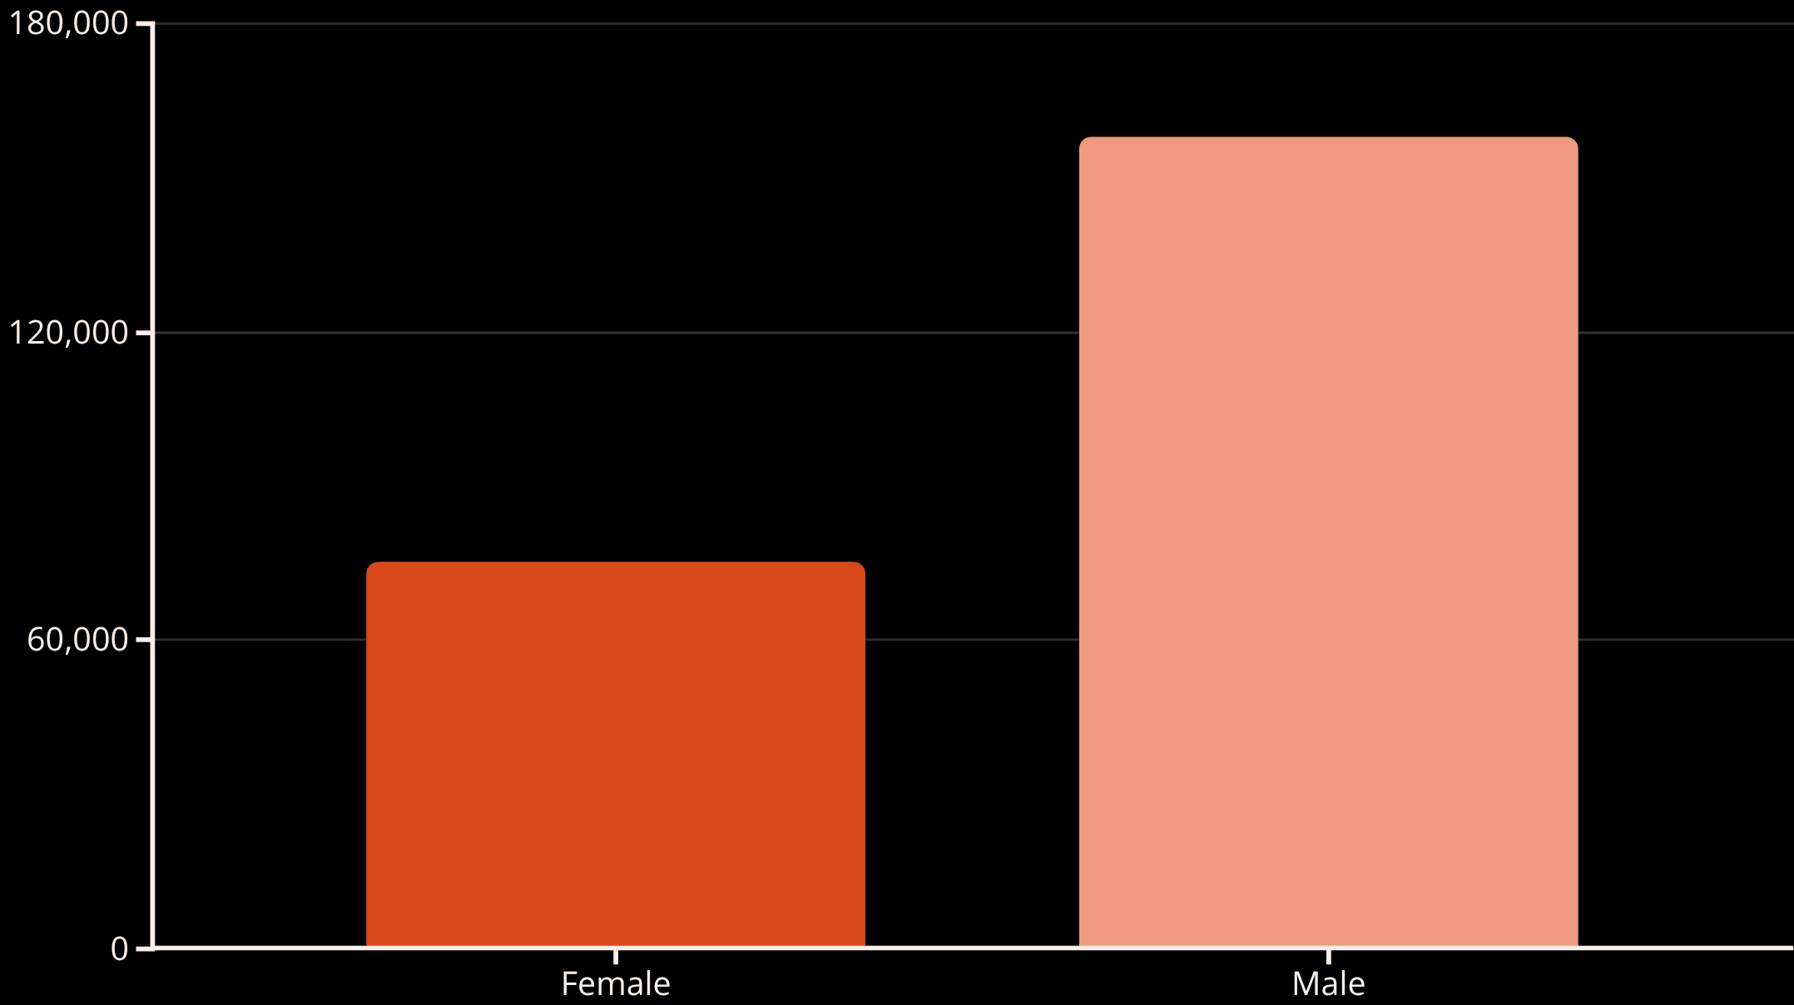
Revenue & Demographics (SQL Results)
Male customers generated higher total revenue than female customers in the dataset.
Average purchase amount across the dataset: $59.76. Average review rating: 3.75.

Slide 6

Product & Rating Insights
Top Products by Average Rating
Gloves — 3.86
Sandals — 3.84
Boots — 3.82
Hat — 3.80
Skirt — 3.78
Highlight these in merchandising and campaigns to leverage positive reviews.

Slide 7
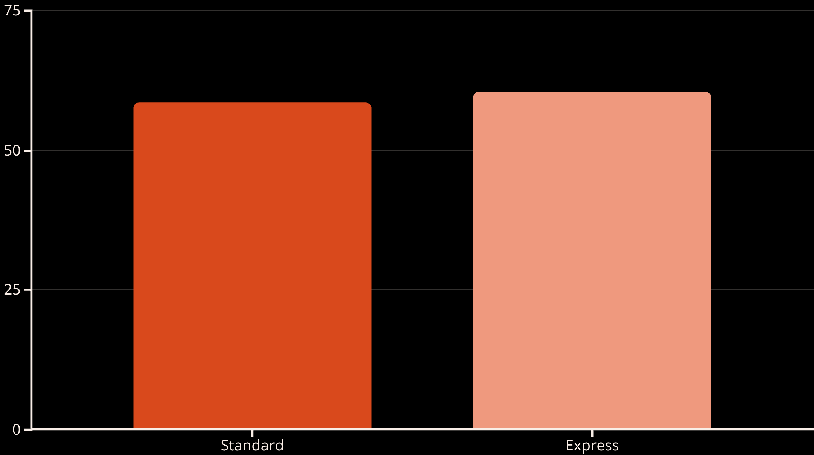
Shipping & Discount Patterns
Discount-Dependent Products
Top items with highest discounted purchase rates: Hat (50.00%), Sneakers (49.66%), Coat (49.07%), Sweater (48.17%), Pants (47.37%).
Consider margin impact when running promotions on these SKUs.

Slide 8
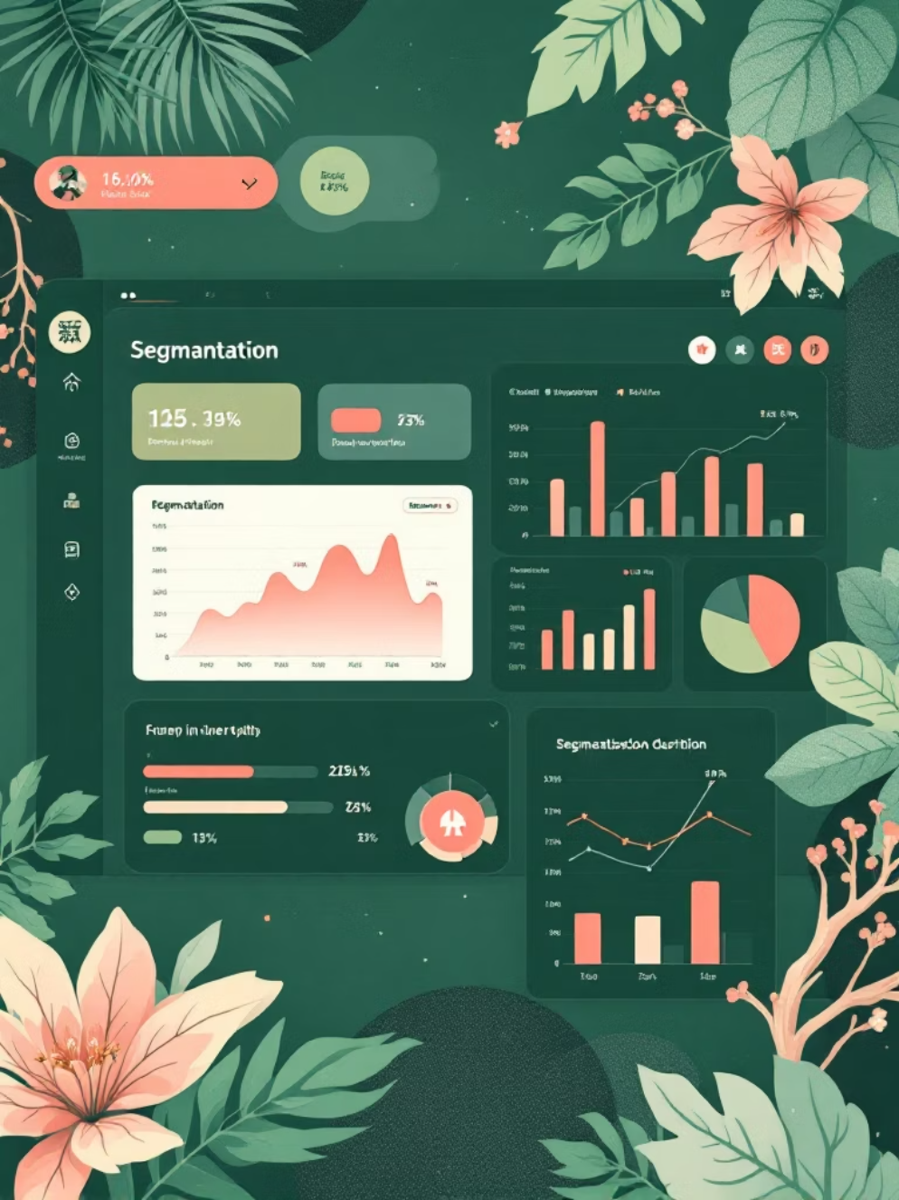


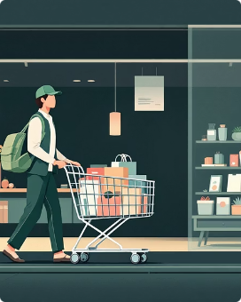
Customer Segmentation
Repeat buyers (>5 purchases): primarily non-subscribers vs. subscribers — check retention levers to convert returning buyers into loyal subscribers.
Loyal
New
Returning
3,116 customers — largest segment.
83 customers — onboarding focus.
701 customers — nurture to loyalty.

Slide 9
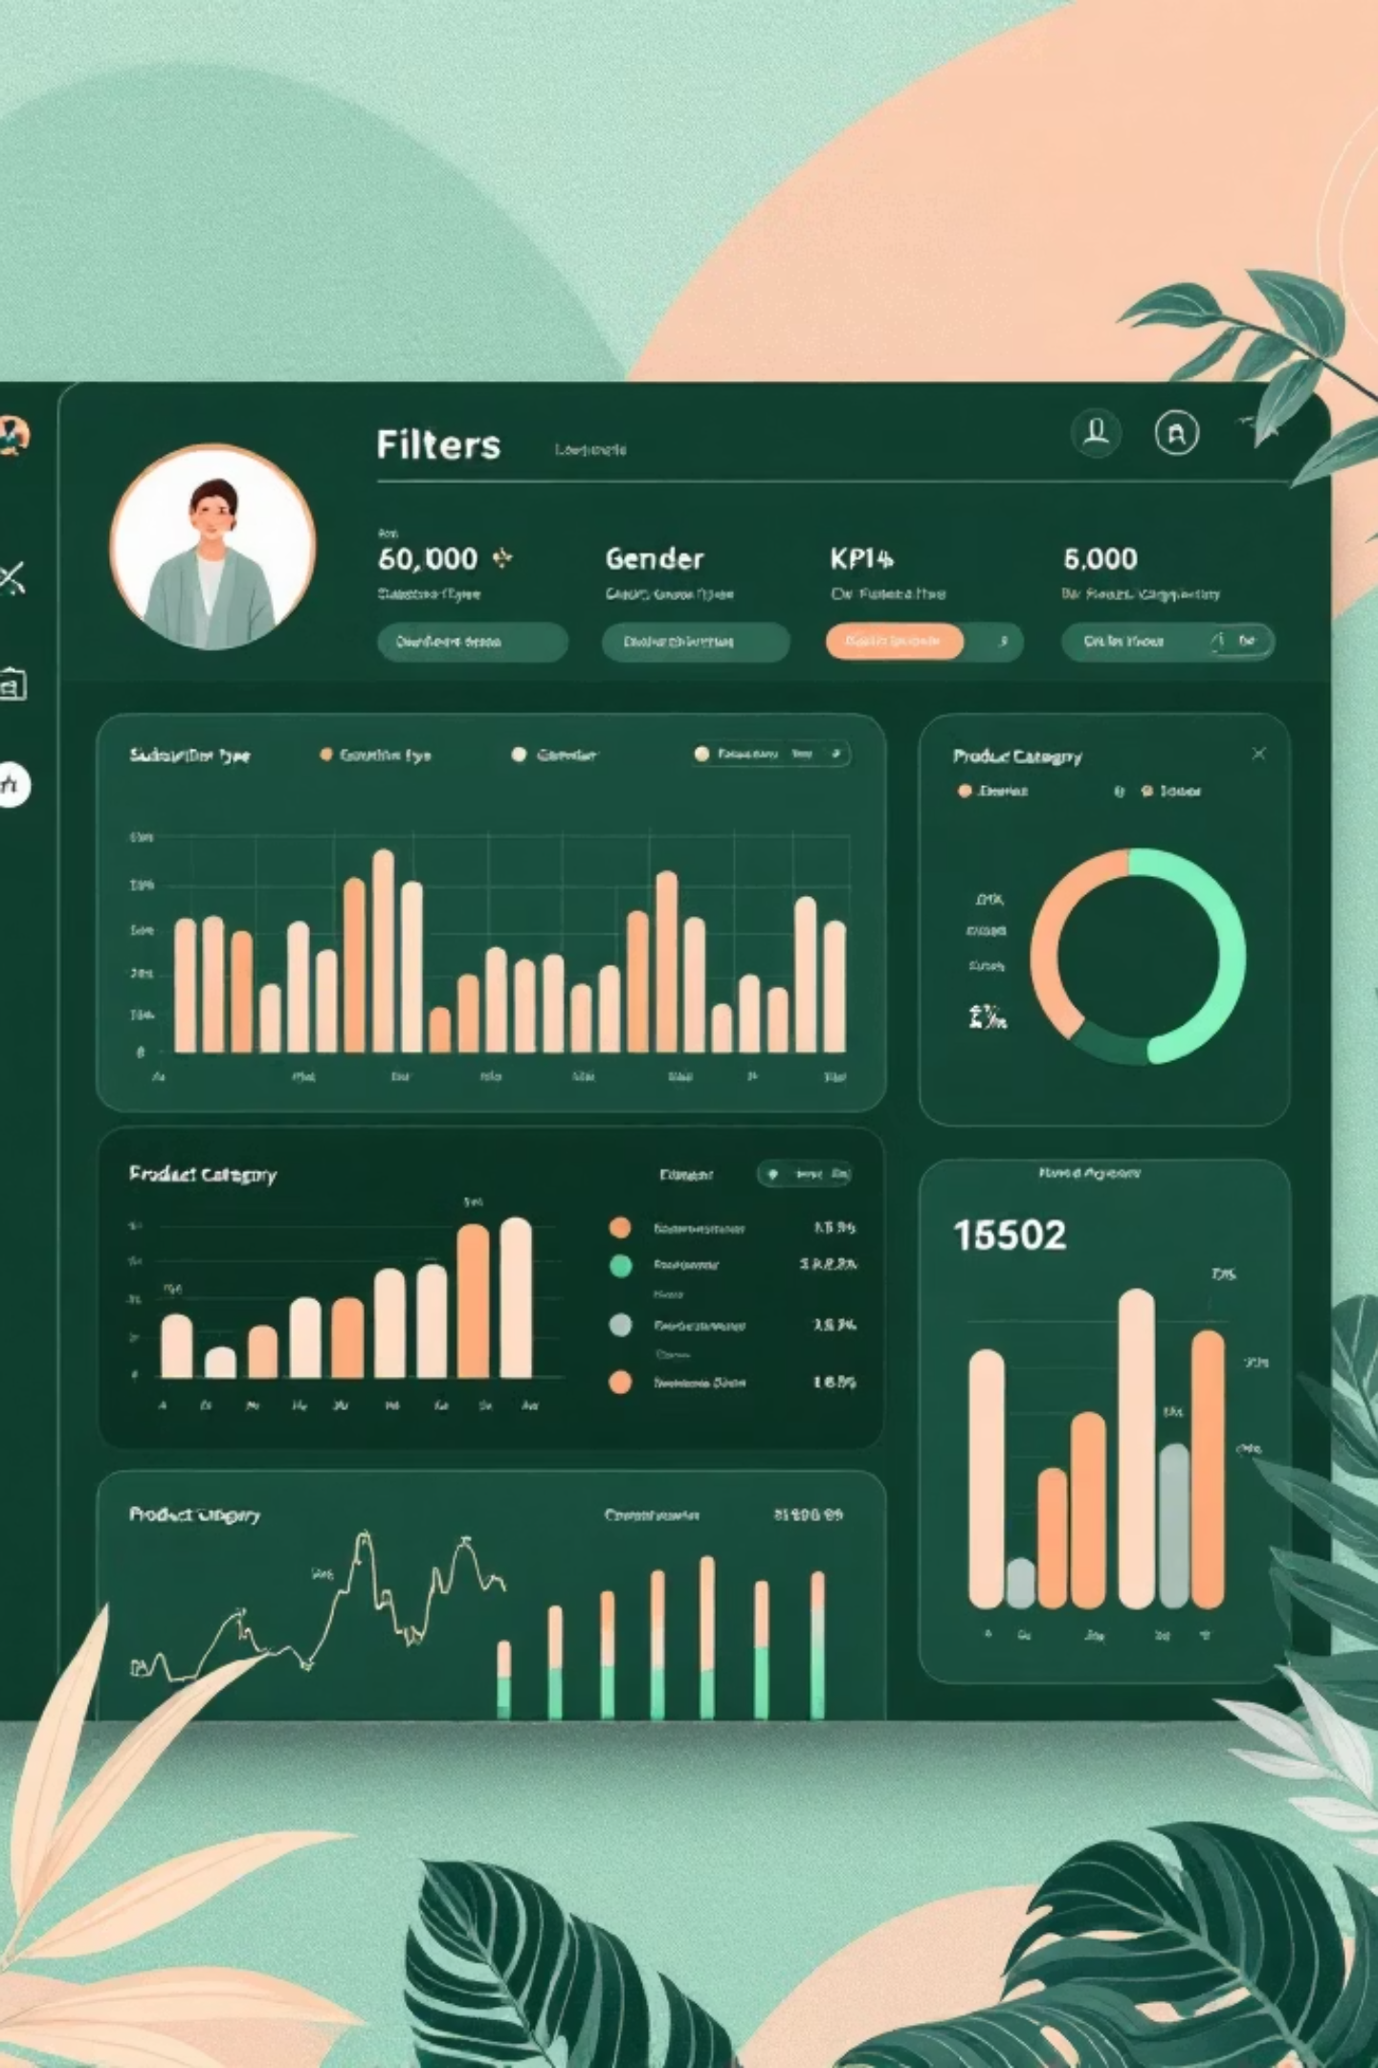
Dashboard Highlights (Power BI)
Key Metrics
Subscription Mix
Customers: 3.9K • Avg Purchase: $59.76 • Avg Rating: 3.75
Yes 27% • No 73%
Revenue by Category
Clothing 100K • Accessories 70K • Footwear 30K • Outerwear 20K

Slide 10
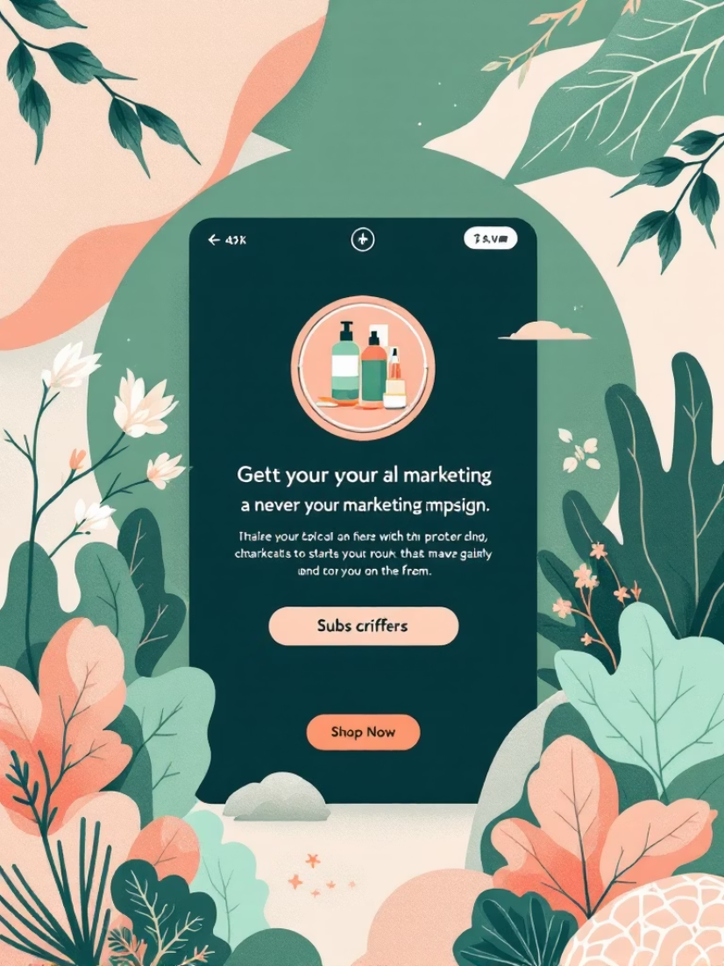
Business Recommendations
Boost Subscriptions
Customer Loyalty Programs
Review Discount Policy
Product Positioning & Targets
Promote exclusive benefits to raise subscriber conversion and lifetime value.
Balance promotional lift with margin impact—focus on non-discounted promotion for top-rated items.
Reward repeat buyers to move them into the Loyal segment.
Highlight top-rated and best-selling products; target high-revenue age groups and express-shipping users.
Next steps: operationalize SQL queries into dashboard widgets, A/B test subscription offers, and monitor discount performance by SKU.

